Slide 1



Oxygen isotopes in Nuclear Lattice Effective Field Theory
Young-Ho Song (RISP, IBS)
NLEFT collaboration
OMEG, 2022.05.27, 여수

Slide 2
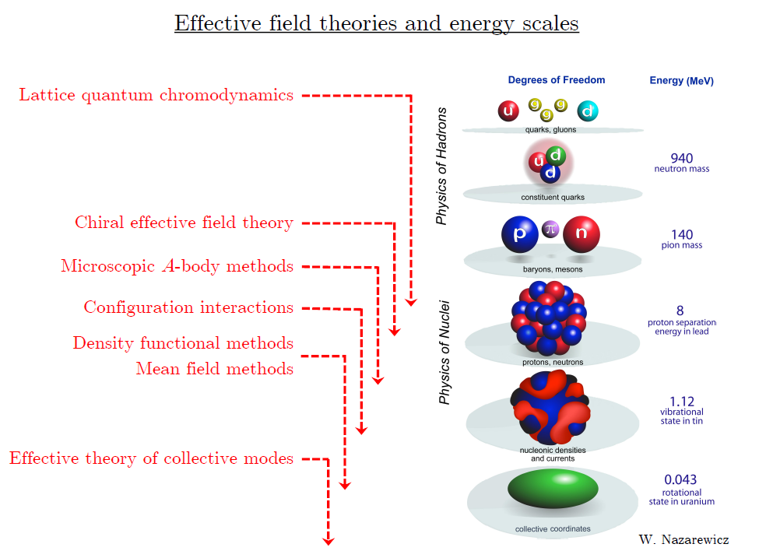
At each scale, there are effective d.o.f. and effective interaction

Slide 3
Ab initio approach
Ab initio (my definition)
= Start from nucleon-nucleon interaction
Ab initio
Nuclear
Theory
Direct understanding of nuclear force and
nuclear structure/reaction

Slide 4
Non-perturbative many-body problem
Nuclear many body problem
Requires Non-perturbative method.
Ab-initio nuclear many body methods
Greens function Monte Carlo(GFMC)
No-core shell model(NCSM)
Coupled Cluster (CC)
IM-SRG, VS-SRG
Nuclear Lattice Effective Field Theory(NLEFT)
With recent progress in ab-initio methods
Binding energies for wide range of nuclei
Some reaction calculation in light nuclei.

Slide 5
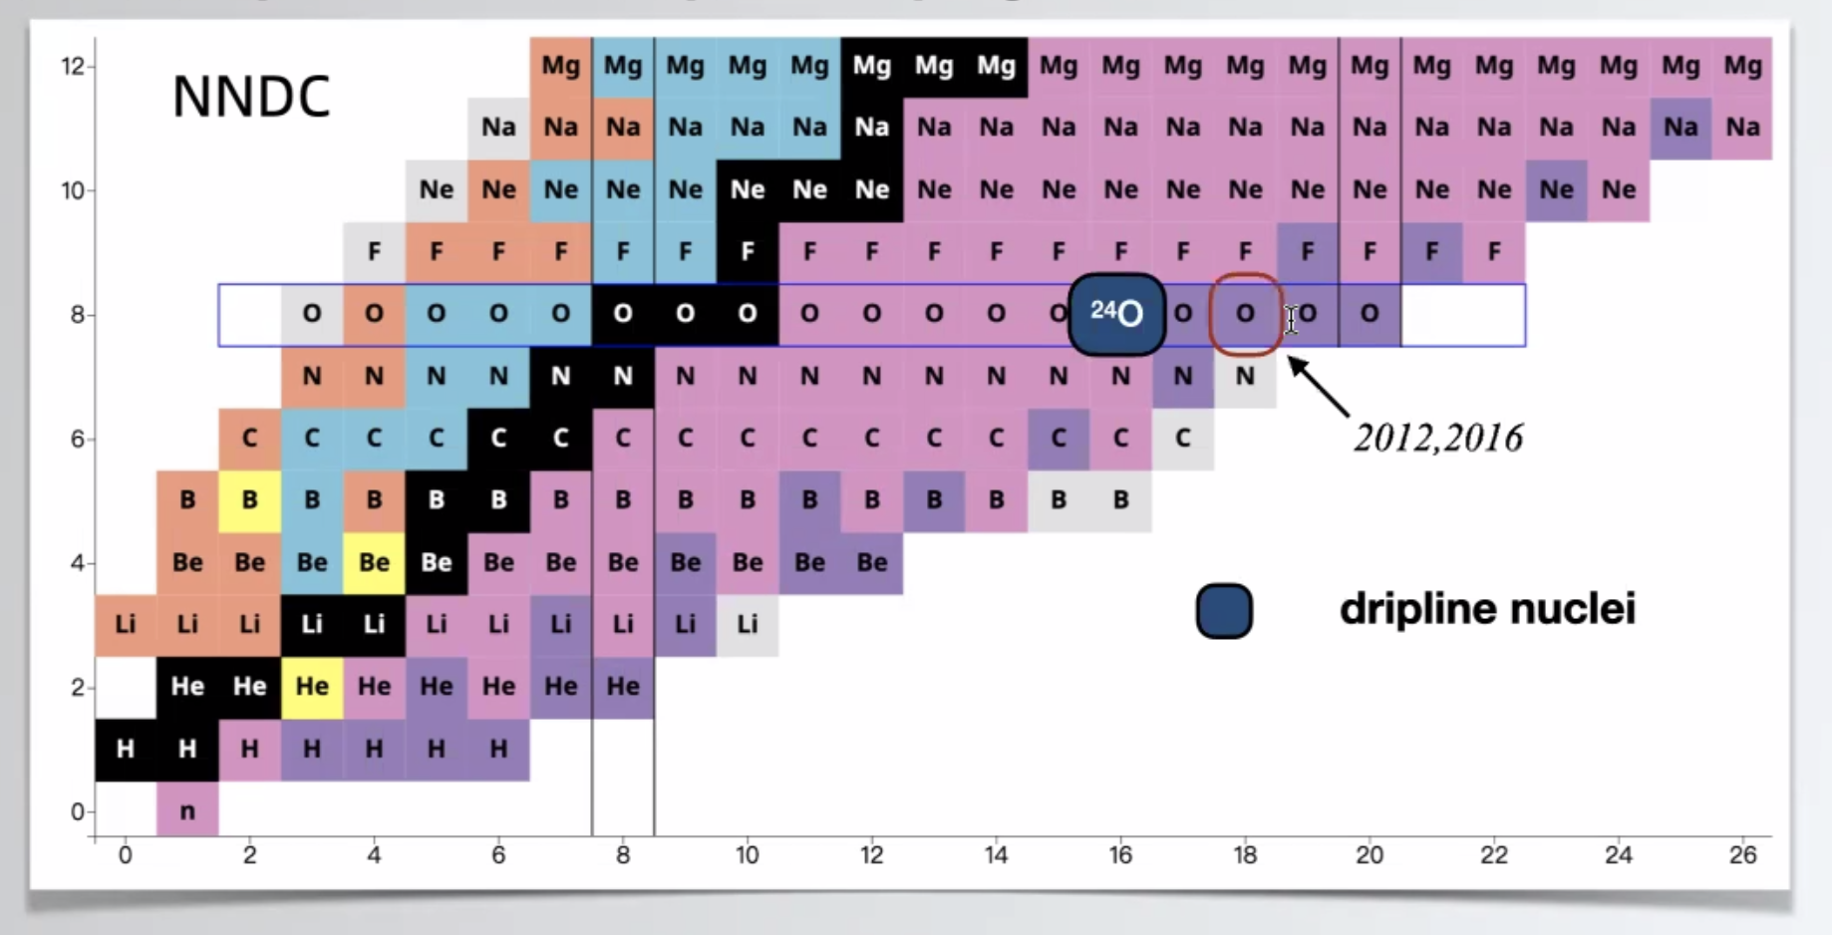
Oxygen isotopes
Can we explain the dripline of Oxygen isotopes?
Role of 3-body force?

Slide 6
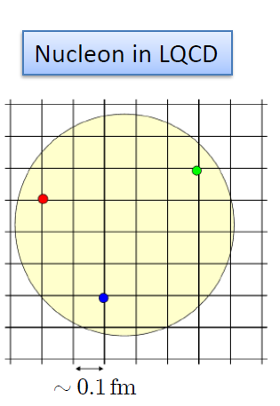
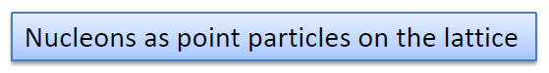
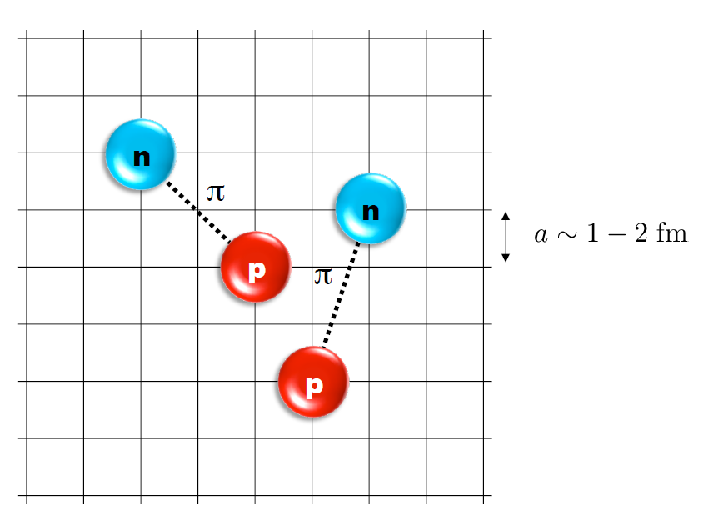
Nuclear Lattice Effective Field Theory
ab initio method for many fermion system

Slide 7
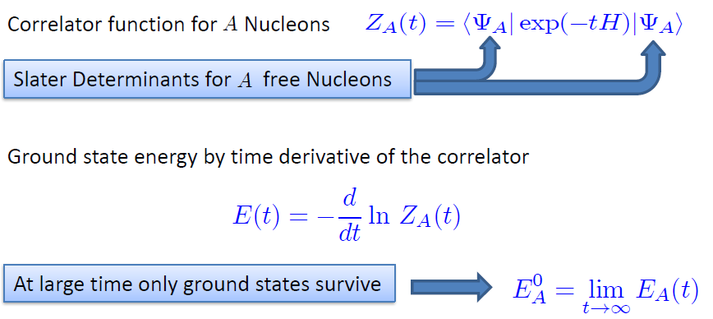
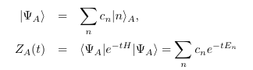
Path integral

Slide 8
Characters of NLEFT
NLEFT is fully quantum mechanical.
NLEFT does not require truncated basis expansions, many-body perturbation theory, or any constraints on the nuclear wave function. Regularization/Truncation is in the lattice spacing.
Alpha clustering emerges naturally.

Slide 9
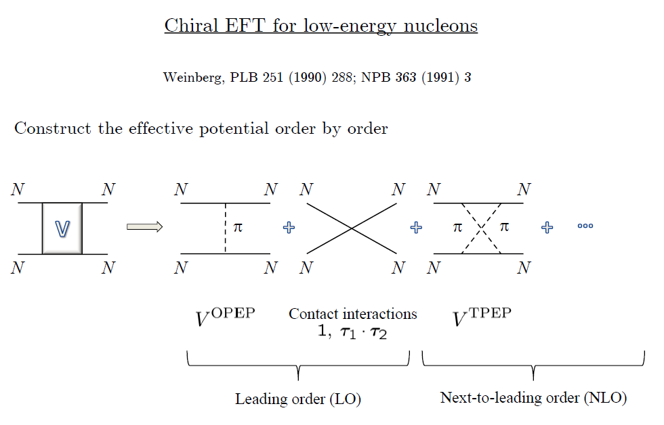
Chiral Effective Field Theory

Slide 10
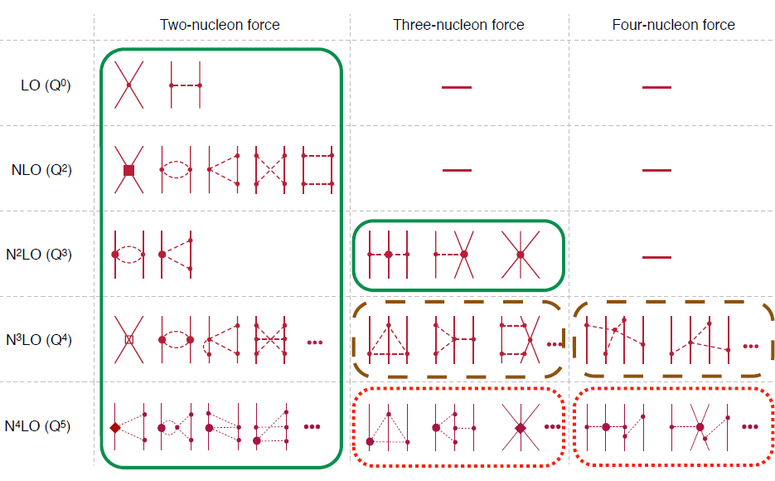
Chiral Effective Field Theory

Slide 11
Lattice Hamiltonian
We need to introduce a lattice scale in space and time:
momentum space cutoff ~ 150 MeV → lattice size a= 1.316 fm
Time cutoff ~ 1000 MeV
We need to determine coefficients of interaction for the lattice size. (regularization scale.)
Two-body interaction coefficients can be determined from phase shifts of np scattering.

Slide 12
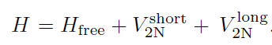
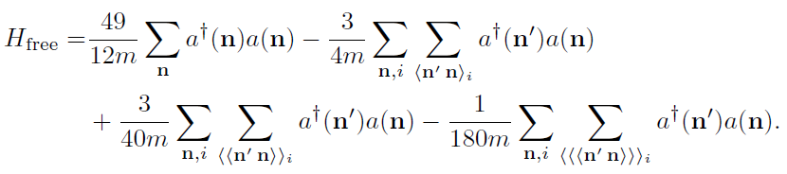
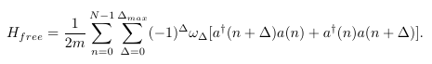
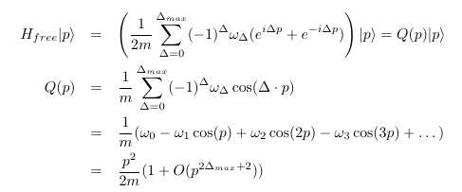
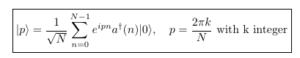
Lattice chiral Hamiltonian at Leading order
At Leading order, kinetic energy + contact interaction + one pion exchange
The Free Hamiltonian is constructed to satisfy free dispersion relation

Slide 13
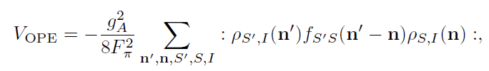
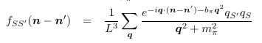
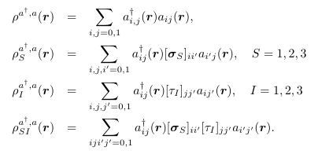
Lattice chiral Hamiltonian at Leading order
One pion exchange

Slide 14
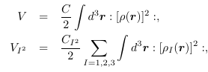
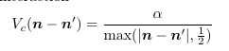
Lattice chiral Hamiltonian at Leading order
Contact interaction: However, we will use a modified contact terms for faster convergence later.
Coulomb interaction can be treated as a perturbation

Slide 15
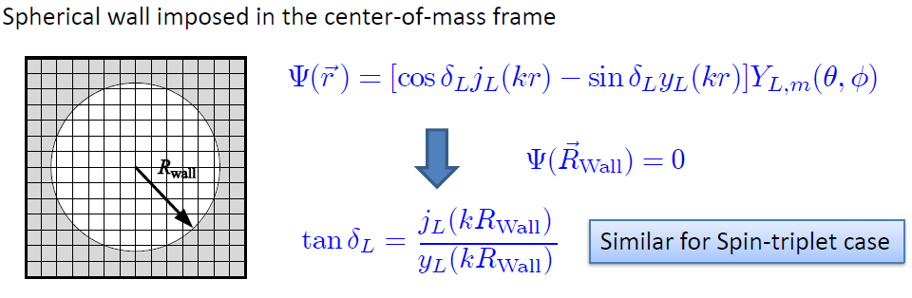
Low energy constants in lattice EFT
LECs(parameters in the Hamiltonian) can be fixed in A<=3
(They have to be fixed for given lattice regularization)
N-P scattering phase shifts, Deuteron binding energy
Triton binding energy, Triton beta decay.
Scattering phase shifts on the Lattice:

Slide 16
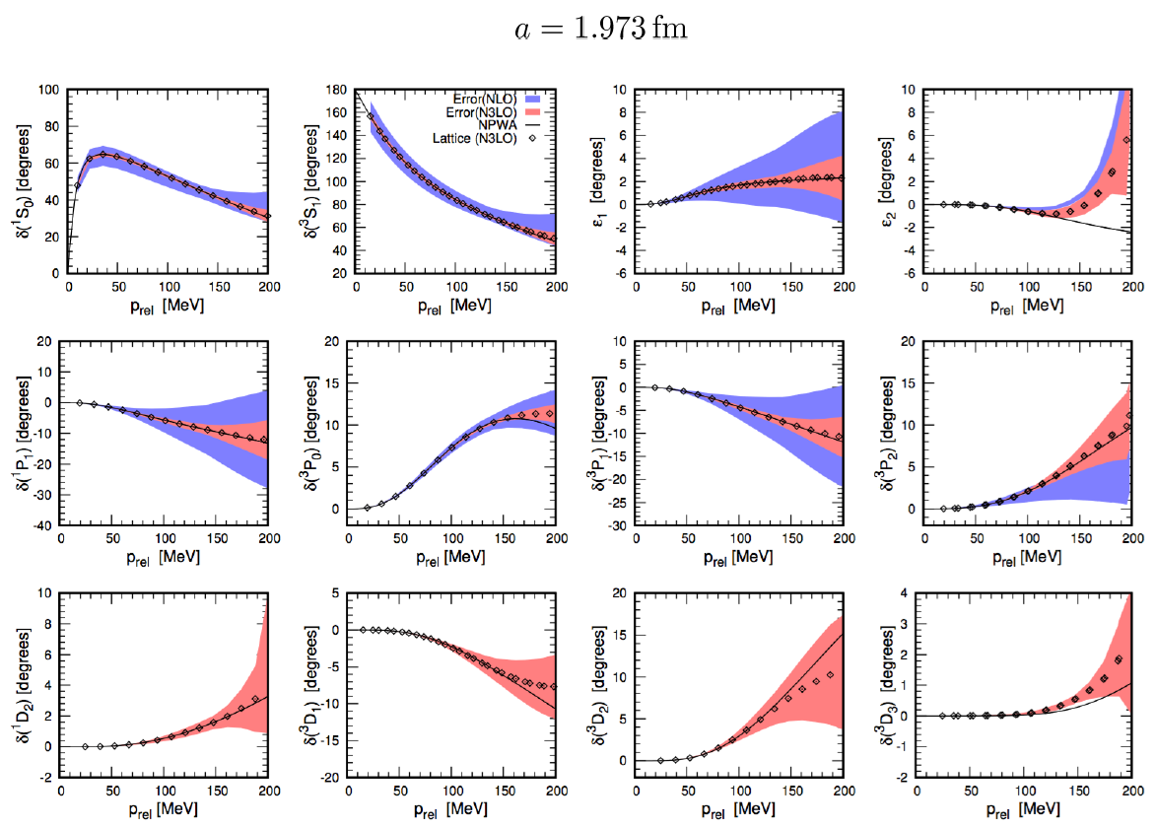
Determine LECs by fitting phase shifts of N-N scattering

Slide 17
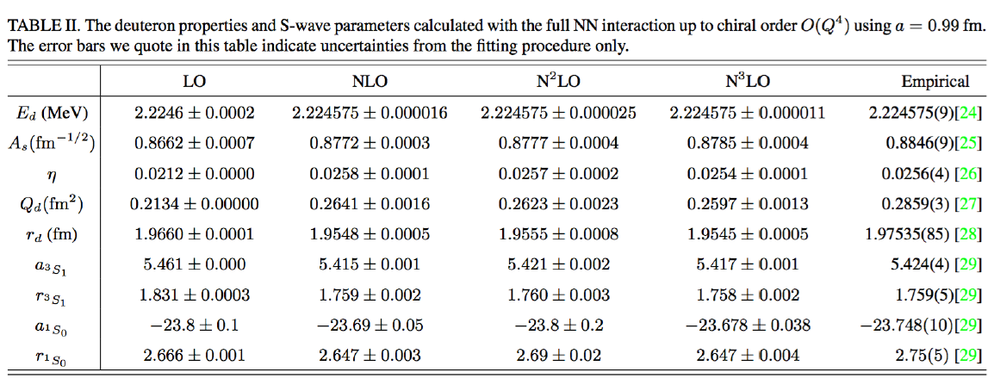

Slide 18
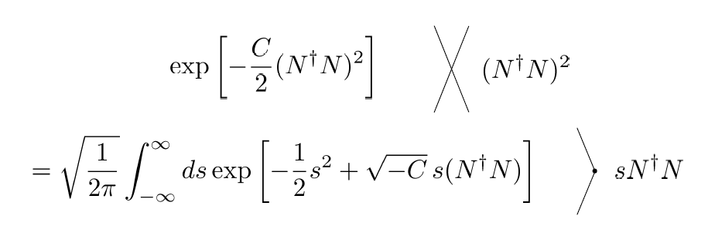
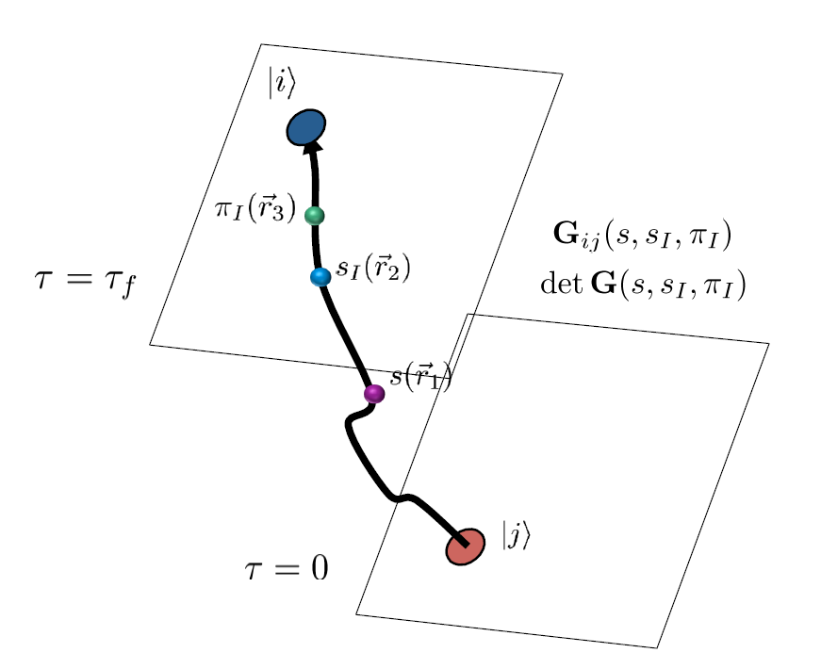
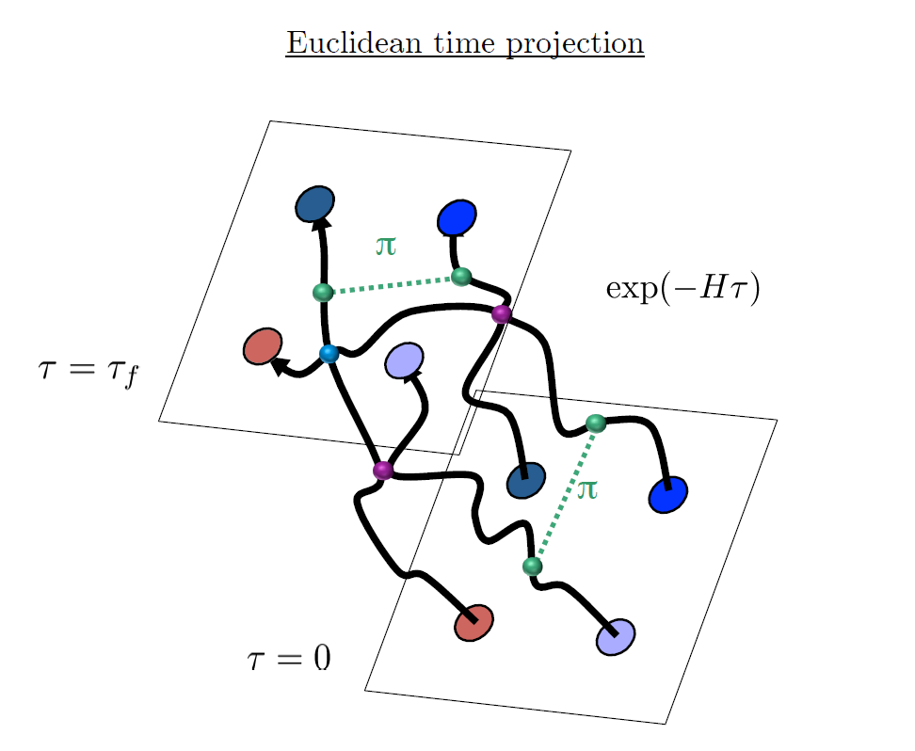
Auxiliary Field Monte Carlo

Slide 19
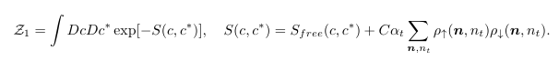
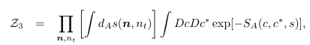
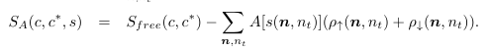
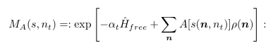
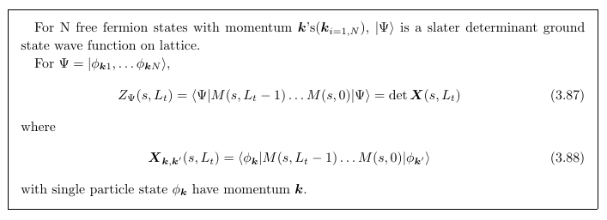
Transfer Matrix Formalism
Monte Carlo integration
By importance sampling of auxiliary fields

Slide 20
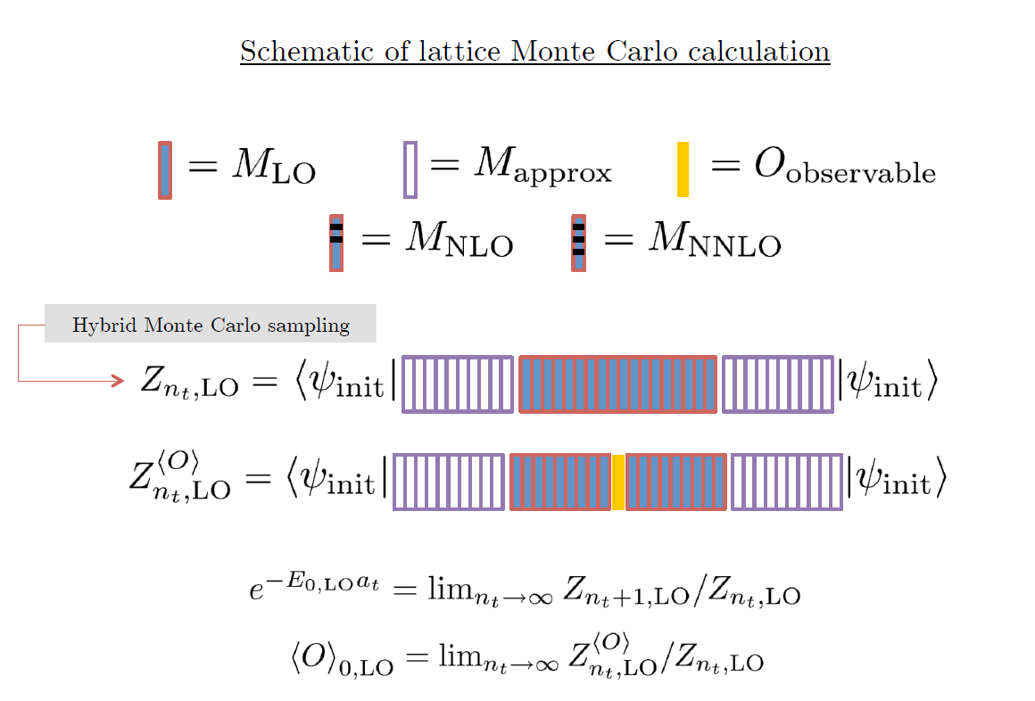

Slide 21
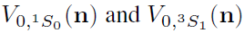
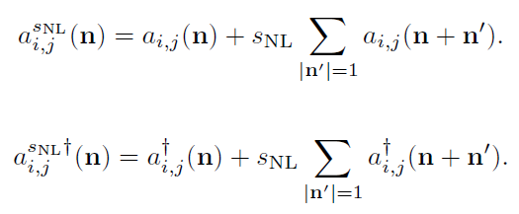
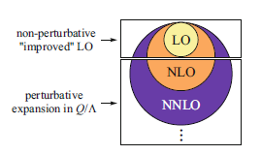
Improved action with non-locality
In practical calculation, sign problem and convergence of perturbation have to be taken care of.
To improve the non-perturbative calculation, modified non-local contact interaction are used.

Slide 22
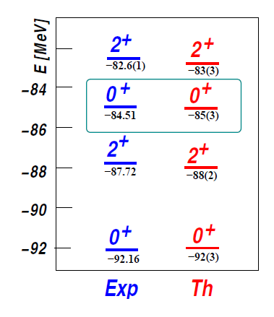
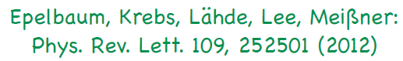
Applications of NLEFT
Has been successfully applied to
Nuclear matter, Cold atom, dilute fermion system
Finite nuclei (A<=50)
First ab-initio calculation of Hoyle state
Cluster structure of ¹²C and ¹⁶O
NN scattering, N-D scattering
Alpha-alpha scattering
radiative capture, fusion
Etc.
The first ab-initio calculation of
Hoyle state

Slide 23
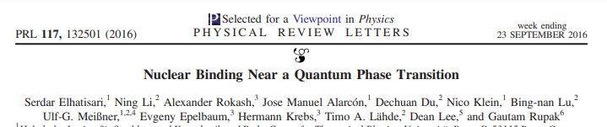
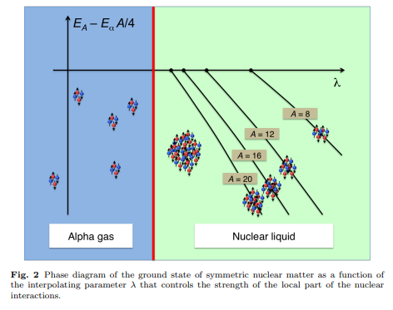
Changing the range and locality of nuclear force
Quantum phase transition
between a nuclear liquid and a Bose-Einstein condensate of alpha clusters
two N-N interaction
which reproduce phase shifts well
They will be equivalent
for two-nucleon observables
Can give very different alpha-alpha
interaction depending the range and
(non)locality of force.

Slide 24
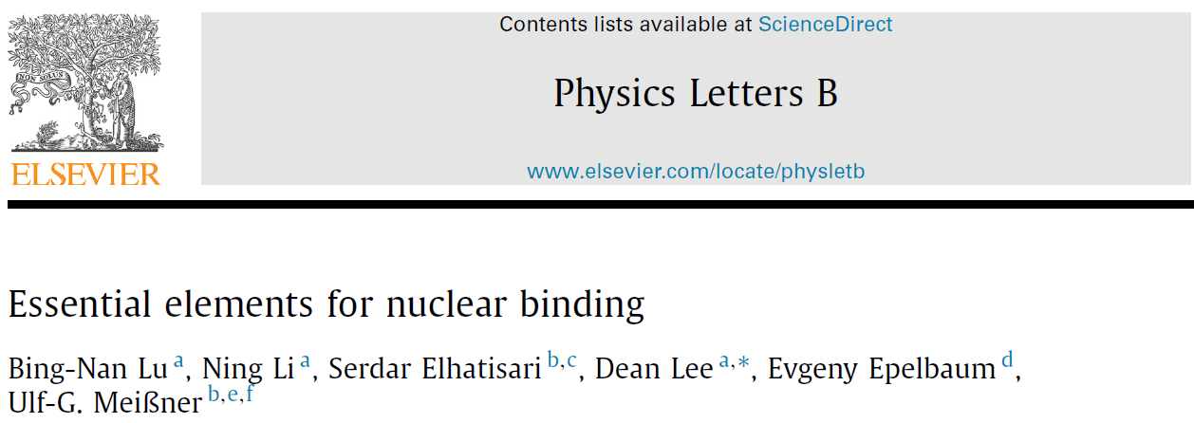
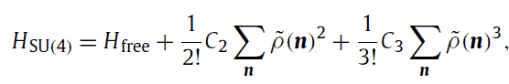
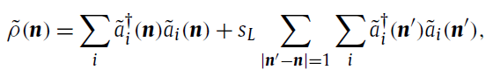
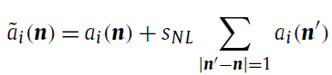
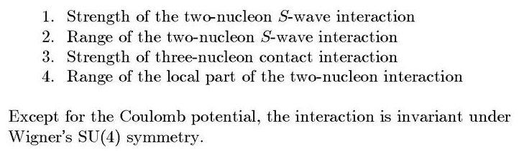
Minimal nuclear interaction
Which reproduce
Light nuclei
medium mass nuclei
neutron matter
simultaneously up to few percent error in binding energy and charge radius
Only Four parameters

Slide 25
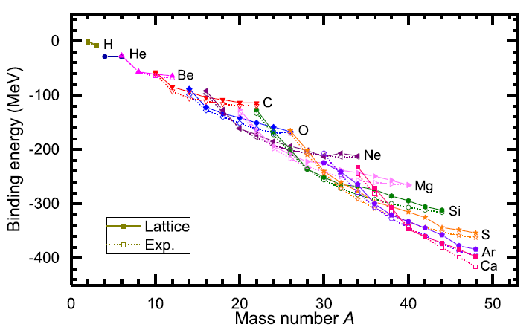
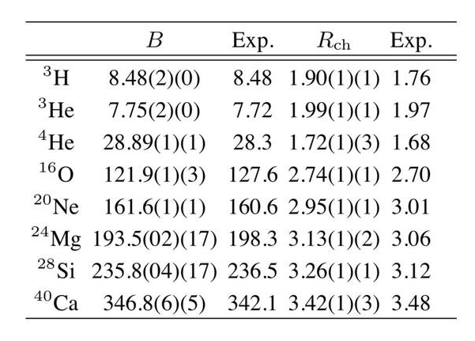
Can we improve the agreement by
Including higher order corrections?

Slide 26
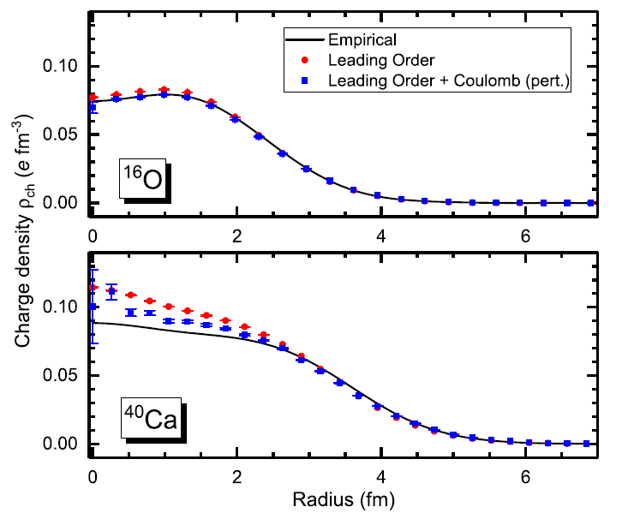
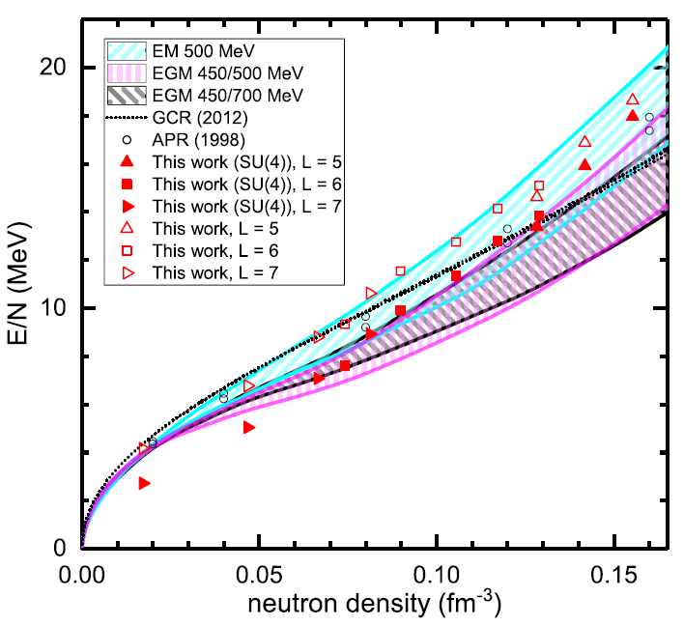
Can we improve the agreement by
Including higher order corrections?

Slide 27
Lattice chiral Hamiltonian (N3LO)
Full N3LO Hamiltonian includes
Free Hamiltonian(Kinetic term)
Short range (nonlocal smeared) contact interactions up to Q^4 order
Isospin-breaking short range interactions
One pion exchange potential
Two pion exchange potential up to Q^4 order
Coulomb interaction
Long range isospin breaking interaction( isospin dependence in OPE)
Galilean Invariance Restoration (GIR) term (because of non-local interaction.)
Three nucleon interaction

Slide 28
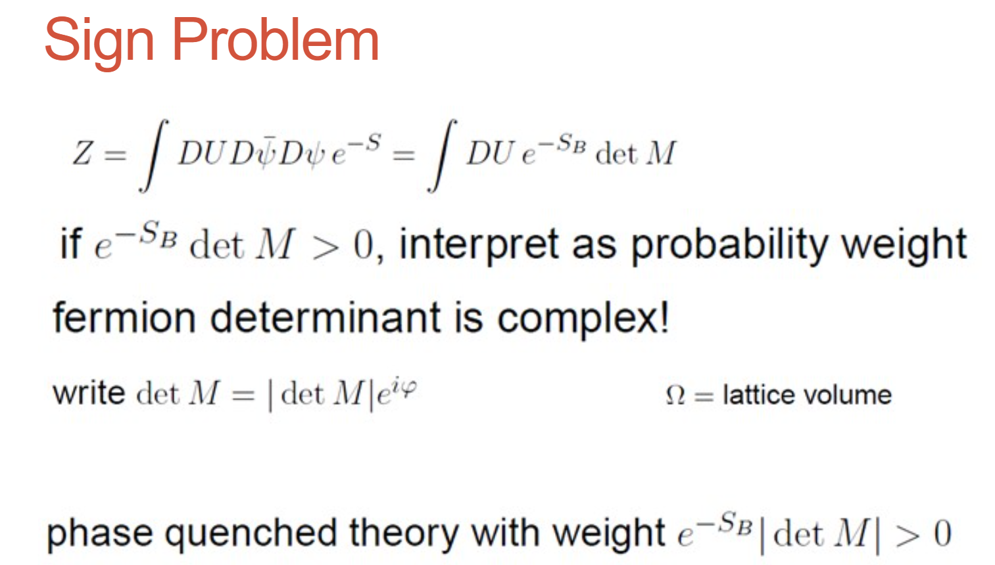

Slide 29
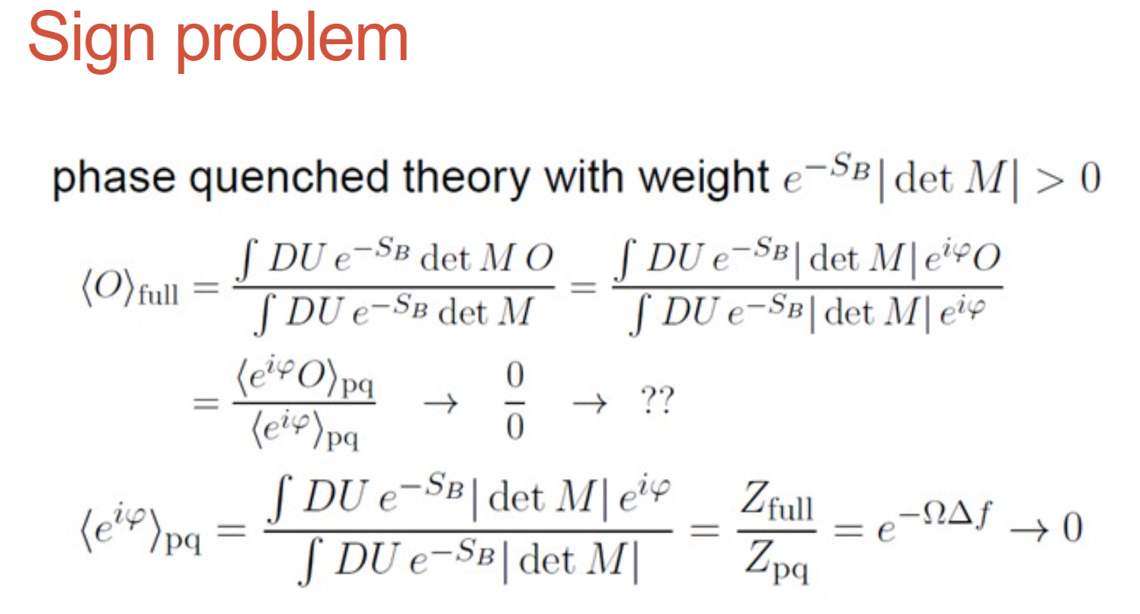

Slide 30
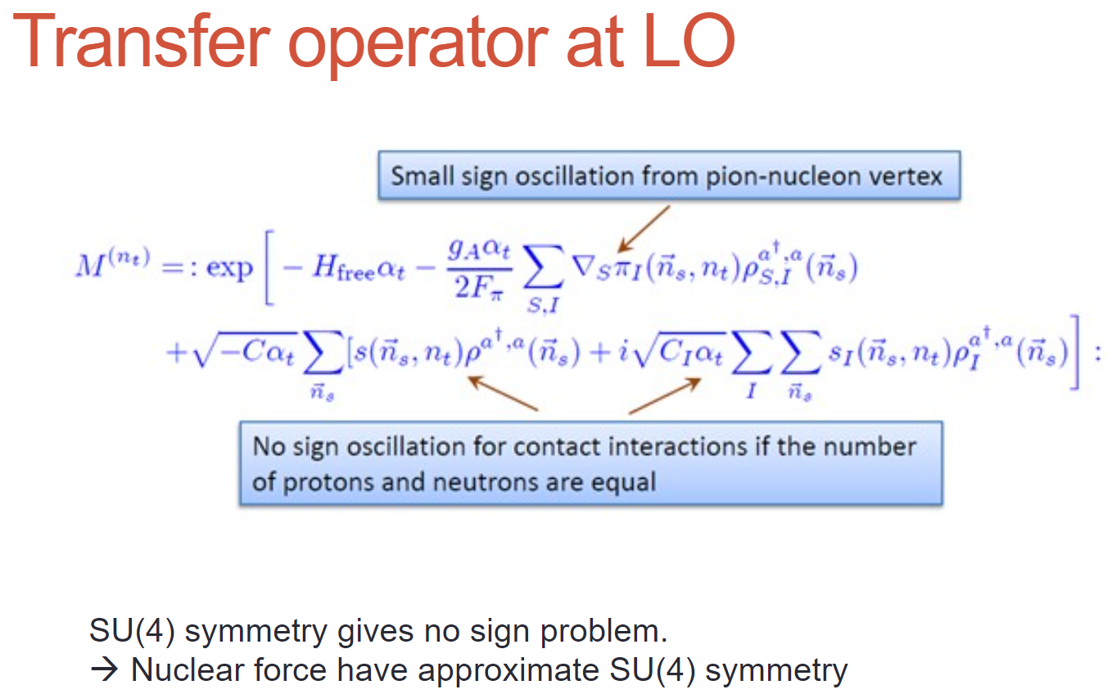

Slide 31
Difficulty with full chiral interaction
Sign problem
NLEFT suffers sign problems at large Euclidean time limit
SU(4) symmetric interaction does not have sign problem
One pion exchange and higher order chiral interaction
Difficulty with Asymmetric nuclei
Needs a remedy to extend to neutron rich isotopes.
A new approach to reduce the sign problem.
→ Wave function matching Hamiltonian.

Slide 32


Slide 33



Slide 34



We would like
to compute
the eigenstates of H_A
Starting from
the eigen-functions
of H_B
and using first-order
Perturbation theory
<psi_B|H_new |psi_B>
To be close to E_A
As much as possible.

Slide 35




Without introducing new Hamiltonian
This does not work well.
This is expected.
Unitary transform
H’_A is equivalent to H_A
(having the same eigenvalues)
One can define non-local interaction V’_A

Slide 36





Slide 37

One can compute perturbative higher order corrections.

Slide 38


Wave Function Matching Hamiltonian
Wave function matching by Unitary transformation
Original Hamiltonian has a strong repulsion at short distance
→ origin of the difficulty of non-perturbative calculation.
new Hamiltonian
such that the eigenstate wave function becomes
Same as “original” w.f. at long distance
Same as “soft” w.f. at short distance
The goal is to make the perturbation expansion with “soft” wave function gives a good convergence

Slide 39
Wave Function Matching Hamiltonian
new Hamiltonian is not the same as original Hamiltonian
Naturally need correction terms
H_wf = H_soft + (U^dagger H U - H_soft)
H_soft has better property for non-perturbative calculation
Perturbative expansion for the corrections
No new LECs in 2-body interaction
(H_soft is a choice. U^dagger H U is computable for 2-body.)
Drawback : Induces many body interactions
In principle, one may compute the induced many-body interactions
In practice, highly non-trivial.
→ introduce additional 3-body interactions and fit them.

Slide 40


Wave function matching Hamiltonian

Slide 41

NN phase shifts from WFM

Slide 42

BE/A from WFM
Preliminary
The filled red-pentagon points are the results for the nuclei which are included in the fit to determine the 3NFs low-energy coefficients, and the open red-pentagon points are predictions.

Slide 43


Charge density from WFM
Preliminary

Slide 44


Nuclear Matter from WFM
Preliminary

Slide 45
Oxygen isotopes in NLEFT
BE agrees well with experimental values for Oxygen isotopes

Slide 46


Oxygen isotopes in NLEFT
Reasonable agreement with experiments
Correct dripline at O24
Slight over binding in O26.→ finite volume effects?
Preliminary

Slide 47
Summary
Wave function matching method seems to be promising
New method to improve the N3LO calculation of NLEFT
Preliminary study shows promising results for wide range of observables
NN scattering
Binding energy (from 3H to 40Ca)
Symmetric Nuclear matter
Neutron matter
Dripline of Oxygen isotope.
Carbon excited states
Further investigation on the finite volume effects is on-going.
Also, Carbon isotopes, odd Oxygen isotopes, Cluster structure, excited states.

